Slide 1


SRM Institute of Science and Technology NCR Campus, Ghaziabad
Team ID-20174
Old Car Details Team ID-19345 Car Number-107 Endurance Score :0 Total Score :0 Awards- 0

Slide 2
In the BAJA 2019 event, we encountered numerious problems, because of which we learned following lessons:
Manufacturing Defects A. Inadequate Strenght at Joints B. More adequate mounting points can be chosen for the front suspensions, as we encountered improper suspension assembly response.
Transportation
A. Arms were made without any bends so they became more rigid and no of joints in arms increased which resulted broken arms during transportaion.
Time Management A. We must learn to follow the Project Plan, as we had been constantly running late on the schedule B. We must avoid the internal rush between the teams at college, for allotment of lab and tools, as in the last event, we wasted approximately 3 months in waiting for the required facilities. C. We must learn to get materials on time, as in the previous event, we encountered many scenarios, when material was delievered much late than the promised time.
Brake-line failure A. Contenous vaccum was not being generated, air was continuously seeping in the brake line through the switches, resulting in loss of vaccum pressure. B. Teflon coating meant to make the assembly leak-proof was also found thick,which also mately resulted in vaccum pressure not being generated.
Workforce Management A. All the team members were not alloted tasks according to their capability. Most of the times, only a few members were working continuously. This time, we made it a point to involve each and every member in the tasks being carried out. This ll definitely result in better time management as well B. Work load was concentrated on only a few members, thus they were exhausted by the time the event actually begun, resulting in overexertion on the overall workforce.

Slide 3
Comparison for Aggregate specifications and Vehicle Performance specifications
Particulars | Proposed | Old
Overall Length | 73.6 inches | 64 Inches
Overall Width | 63 inches | 56Inches(F) 54Inches(R)
Ground Clearance | 12 inches | 14Inches(F) 12Inches(R)
Wheelbase | 50Inches | 42Inches
Track Width | 56 inches(F) 53 inches(R) | 45Inches(F) 39Inches(R)
Roll Cage Material | AISI 4130 | AISI 4130
Overall Weight | 275Kg | 260kg
Engine | Briggs & Stratton 305 cc 10HP | Briggs & Stratton 305 cc 10HP
Transmission | Custom single speed reduction gear box with CVT | Custom single speed reduction gear box with CVT
Tires | 25x8-12 (R) 25x7-10(F) | 25x8-12 (R) 25x7-10(F)
Maximum Speed ( Kmph ) | 53.1 KMPH | 56.73 KMPH
Maximum Acceleration | 1.2 m/s² | 7.37 m/s²
Gradiability % | 49.74 degree | 45 Degree
Stopping Distance | 5.95 meters | 5.97Meters
Kerb Weight/ Ratio FAW to RAW- laden | 205Kg/ 1.15 | 190Kg/ 1.15

Slide 4
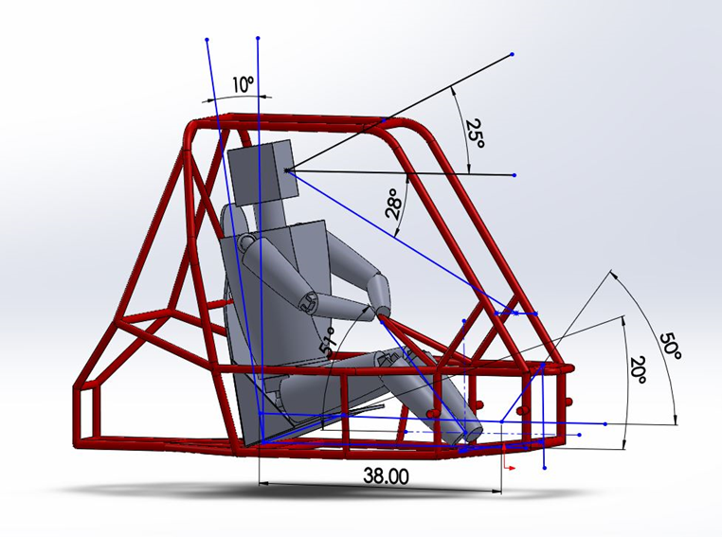
Ergonomics
The driver’s helmet has 152 mm (6 in.) clearance to the side surfaces.
Driver’s shoulders, torso, hips, thighs, knees, arms, elbows, and hands has 76 mm (3 in.) clearance.
Driver emerging out of the car within 3 seconds.
Frame Distance from Driver In compliance with Rulebook Specifications
Adjustable and optional thigh pads seat with a train to adjust distance from steering wheel. Pre Fabricated seat of Sparco, FIA Certified
Padded sharp edges over the entire vehicle and frames in cockpit to ensure safety of driver and track crew.
Rule book Study
PHASE 1
Rectangle Of Max. Dimensions
PHASE 2
Driver Dimensions
PHASE 3
PVC model
PHASE 4
Initial CAD Design
PHASE 5
Final Vehicle Design
PHASE 6

Slide 5
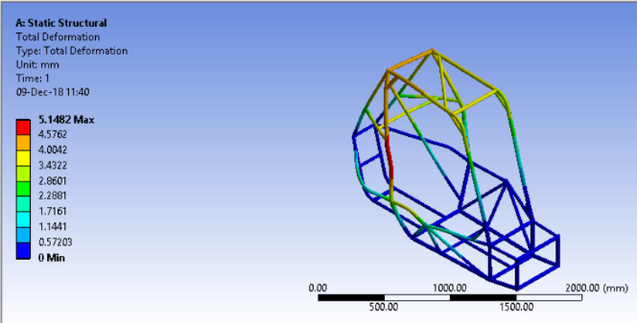
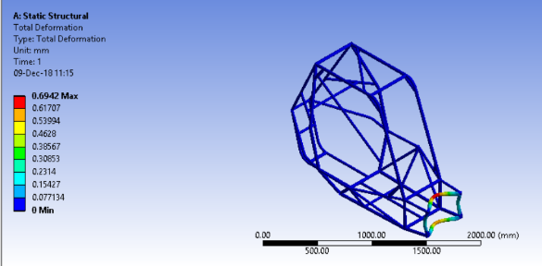
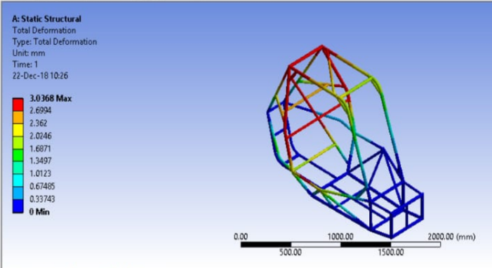
COMPUTER AIDED ENGINEERING
Selection Criteria :Maximise inertia & Minimise cross sectional area
Meshing size :0.08537554”
Proposed FOS :2
Max Deformation :14mm
Type of Mesh :Tetrahedron (2D elements)
SIDE IMPACT
FRONT IMPACT
IMPACTS | FRONT | SIDE | ROLLOVER | REAR
Stress(N/mm²) | 533.5 | 106.69 | 533.5 | 533.5
Deformation(mm) | 1.87 | 7.50 | 16.88 | 3.75
FOS | 1.68 | 1.14 | 1.81 | 2.2
Beam method used for spaceframe chassis and shell method used for monocoque chassis
Choosing solver- COSMOS
Constraints – suspension points, Rulebook
Chemical Composition : Mn(.50) S(.04) P(.035) C(.300)
PROPERTIES | YIELD STRENGTH | UTS | ELONGATION
AISI 4130 | 640MPa | 560MPa | 28.2%

Slide 6
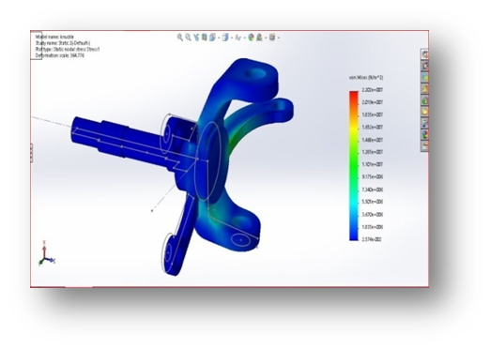
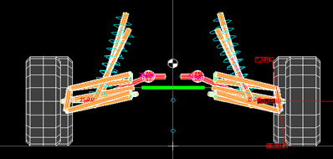
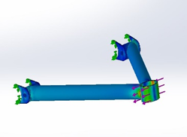
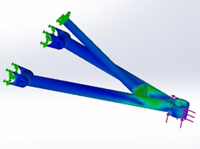
SUSPENSION GEOMETRY | VALUES
Camber | 0
Castor | 3 degree
KPI | 5.4 degree
Scrub Radius | 1.92 inches
Toe | 0
Kerb Weight | 205kg
Spring wire dia | 12mm
Spring Material | ASTM A228
Spirng FOS | 1.5
Damping Value(N-s/m) | 404(F) 417(R)
Wheel Travel Front Wheel Travel Rear | + -50mm + -43mm
SUSPENSION
Double Wishbone Independent-FOX AIR SHOCK 2.0 Suspension
SUSPENSION LINKAGE | VALUES
CG Height | 25inch
Clearance(F/R) | 16”/14”
Roll Centre Height at FAW | 10.5in
Roll Centre Height at RAW | 18.25in
Motion Ratio F/R | 0.8/0.6
Wheel Rate F/R | 5.88N/mm(F)2.5N/mm(R)
SUSPENSION DESIGN | VALUES
Sprung Mass at Front/Rear | 97.65kg/119.35kg
Unsprung Mass at Front/Rear | 22kg/21kg
Natural Frequency – Front/Rear | 1.3Hz/1.5Hz
Ride Rate Front/Rear | 1.65N/mm/ 2.68N/mm
Spring Stiffness F/R | 9.2N/mm/6.93N/mm
Suspension Travel F/R | 4in/6.65in
Damping Coefficient | .35
Arms design optimization in solidworks

Slide 7
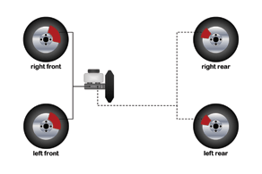
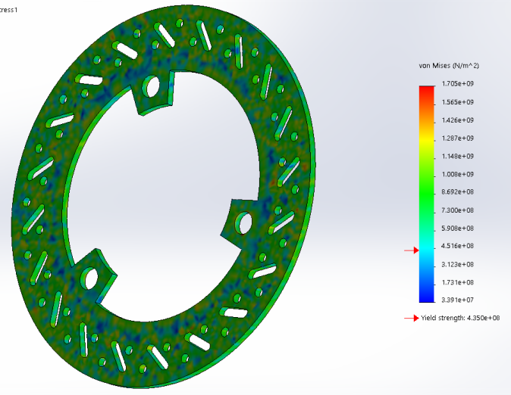
BRAKING CIRCUIT
BRAKES
BRAKING CALCULATION
SPECIFICATIONS | VALUE
Split system | F/R split
Master cylinder bore size*stroke | 0.86x1.18inch
Brake | Disc
Brake caliper bore size*no | F- 0.90inchx2 R-1.37inchx1
Brake caliper pad-mean braking radius | 2.89inch
Brake caliper pad-area | 1.77inch^2
Brake caliper pad- friction coefficient | 0.43
Brake fluid used | Dot 4
SPECIFICATION | VALUE
Weight transfer | 70:30:00
Static Rolling radius for tire | 12.303inch
COF of road | 0.3
Brake torque per wheel | F/R 323.83N-m /357.187N-m
Force by caliper cylinders | F/R 2948.49N/3796.48
Wheel lock first | Rear
Balance between two braking circuits | Tandem Master Cylinder
BRAKE INSTALLATION PROBLEMS –ACTIONS?
Bleeding | Pump and hold
Caliper type | Floating
BRAKING PERFORMANCE
SPECIFICATIONS | VALUE
Pedal force | 300N
Pedal travel | 50mm
Stopping distance | 5.97m
Pedal ratio | 5:1
BRAKE INSTALLATION PROBLEMS
Bleeding | Use of Bleeding syringes, Maintaining pressure in hoses using nylon tapes using pump and hold technique
Unbalanced Circuits | Check for undue long hoses and any slacks, CorrecTandem Master Cylinder Working

Slide 8
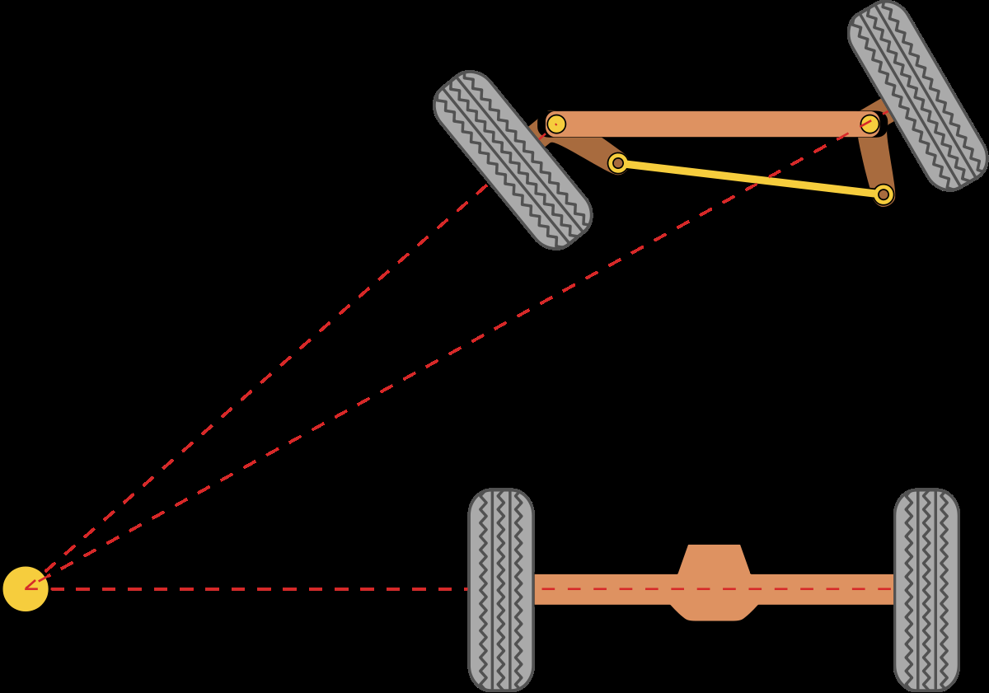
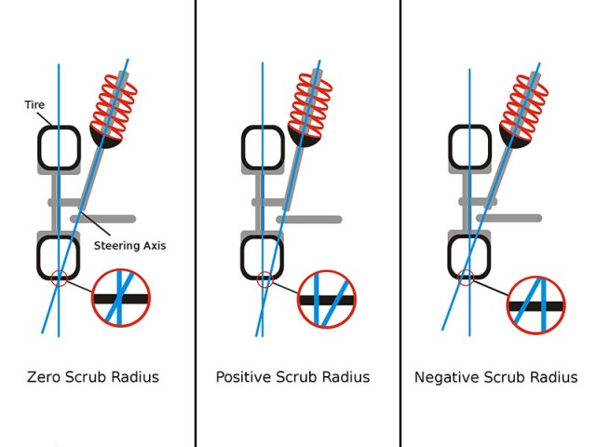
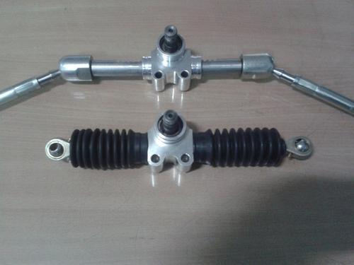
STEERING
SPECIFICATION | VALUE
Rack travel | 12.8 cm
Steering wheel torque | 8764N-mm
Steering ratio | 8:1
IBJ center distance | 153mm
OBJ center distance | 564mm
Length of tie rod | 15inch
Steering column type | Rack & pinion
Steering wheel diameter | 11 inches
Turning radius | 1.9 meter
Ackerman angle | 70.3degree
SPECIFICATION | VALUE
Track width F/R | 52inches/46 inches
Wheel base | 48.09 inches
Power assist | No
% ackerman | 70.3%
Under steer
Steering type | central
SPECIFICATIONS | VALUE
Caster | 3 degree
Camber | 0
Lock to lock revolutions | ¾ turns
Toe | 0
Steering system used – Rack & pinion
Turning angles – interior 44.5 degree /outside 24.5 degrees
Camber - (less steering effect)
Under steer
at turns Ackerman geometry followed Tire size: 25x7/10(F) 25x8/12(R) LHD Neither Collapsible nor tilting

Slide 9
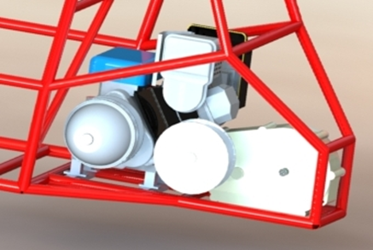
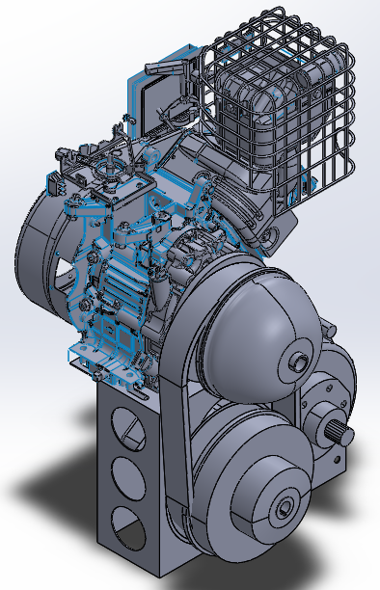
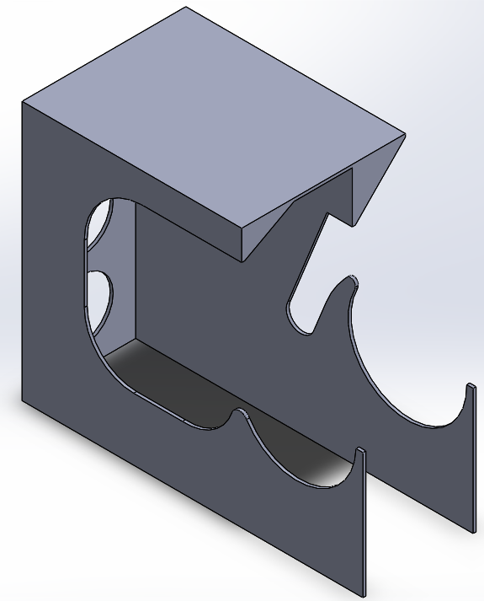
POWER TRAIN
PERFORMANCE
ACCELERATION | 7.28m/s²
GRADIABILITY | 49.74 degree
POWER TRAIN LAYOUT Engine → CVT → Gearbox → Wheels
Custom Gearbox With CVT - CVtech
Engine and Gearbox coupled using a CVT with a V-Belt Tire size- 25x7/10(F) 25x8/12(R)
ENGINE SPECIFICATIONS
MAXIMUM POWER | 10 HP
MAXIMUM TORQUE | 14 lbs-ft @ 2800 RPM
Integration
NVH Considerations | 1) Aligned and balanced wheels 2) PU Sheet placed under engine 3) 75cm of clearance of seat from front suspension assembly
GEARBOX DATA
GEAR RATIO | 14.69
NO. OF REDUCTION STAGES | 2
MODULE I STAGE | 2.5
MODULE II STAGE | 2.5
GEAR AND SHAFT MATERIAL | EN24
CASING MATERIAL | Al6061-T6

Slide 10
Components | Cost
Steering System | 10,200
Tie Rod | 2,000
Custom Made Steering rack | 5,000
Steering wheel | 3,200
Brake Assembly | 30,500
Caliper | 20,000
Disc | 8,000
Aluminium Housing | 1,500
Brake Pads | 1,000
Suspension Assembly | 3,08,000
Suspension Assembly | 2,00,000
Knukle Hub | 96,000
Spindles | 6,000
A-ARM | 6,000
Transmission | 87,000
Coupling | 10,000
CVT | 42,000
Gearbox | 35,000
Drive Train | 60,000
Axle | 10,000
Tyres+Rim | 50,000
Body | 3,000
Body Fenders | 3,000
Frame | 42,000
Roll Cage | 35,000
Seat | 5,000
Firewall | 2,000
Components | Cost
Engine | 54,000
Engine | 46,000
Fuel Tank | 2,500
Exhaust System | 6,500
Electrical | 16,400
Harness | 8,500
Brake Lights | 5,000
Battery | 2,900
Safety Equipments | 56,000
Safety Harness | 5,000
Fire Extinguisher | 700
Kill Switch | 300
Driving Gear | 50,000
Fasteners | 3,500
Nuts | 1,500
Bolts | 1,500
Spring Washer | 500
Miscellaneous | 25,000
Other Charges | 25,000
Total | 6,95,600
COMPONENTS | WEIGHT
Frame | 35Kg
Steering System | 10Kg
Brake Assembly | 5Kg
Suspension | 30Kg
Transmission | 85Kg
Wheels and Tires | 80Kg
Panels and Body Works | 10Kg
Miscellaneous | 20Kg

Slide 11
Project Plan

Slide 12
Systems | Components | Failure Mode | Effects on System | S | O | D | RPN | Applicable control(s )
PFMEA
WELDING | Current regulator | 1.Insufficient welding current | 1.Weak weld 2.less penetration | 9 | 5 | 4 | 180 | 1.Parameter should be regulated
HOBBING MACHINE | Hobbling tool | 1.Incorrect module 2.Incorrect tooth profile | 1.Interface between gears 2.Egg shape | 8 | 3 | 6 | 144 | 1.Implement a gauge to measure the width of the teeth of gears
CNC | Motor drive controller | 1.Electronic fail | 1.Motor will not work or work improperly | 9 | 4 | 4 | 144 | 1.Include preventive measure like fuses
WATER JET CUTTING | Controller | 1.Revised program not loaded | 1.Parts with missing slots/holes | 8 | 7 | 2 | 112 | 1.No error proof program
DFMEA
ROLLCAGE | RRH,RHO,FBM,LC ,FLC,LDB,LFS,SIM,FAB | 1.Improper force analysis 2.Wrong force determnation | 1.Failure of primary or secondary members | 9 | 4 | 4 | 144 | 1.Proper techniques of welding using MIG 2.Analysis of forces on various members
SUSPENSION AND STEERING | Air shocks,Arms,Upright Ball joints,tie rod,hub | 1.Improper selection of module 2.Wrong selection of suspension mounting points | 1.Failure of pinion 2.failure of ball joint | 9 | 5 | 4 | 180 | 1.Multiple iteration of module and taking high fos
BRAKING SYSTEM | Pedals,TMC | 1.Lack of heat dissipation | 1.Deformation of disc | 9 | 5 | 3 | 135 | 1.High heat dissipation
POWER TRAIN | CVT,Engine,Gearbox | 1.Improper design of gear | 1.Failure of powertrain | 9 | 7 | 3 | 189 | 1.Take high fos as this is a critical part

Slide 13
User Needs
REVIEW
Design Input
Design Process
Verification
Design Output
Validation
BAJA Vehicle

Slide 14
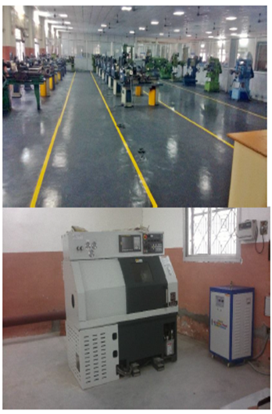
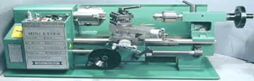
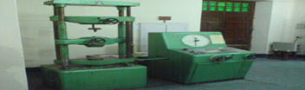
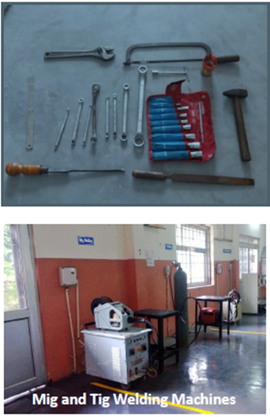
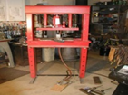

Team Composition, Manufacturing and testing facilities
DEPARTMENT | MEMBERS
Faculty Advisor | Kannan M.
Captain | Parth Jain*
Vice Captain | Ansh*
Suspension | Sumedha, Aryan*, Nimish*
Steering | Tarun, Tanay*, Shreya, Prithvi*
Transmission | Kshitij, Ansh*, Prateek*
Braking and Tires | Deena, Annirudha, Rajat, Subhojit*
Design and Development | Parth*, Vaibhav, Shivansh*
Research and Development | Shreyash, Vanshaj, Satwik
Marketing | Parnika, Vreshabbhan*, Agrata
Drivers | Parth*, Ansh*
Electrical | Sayantan, Shantanu
‘*’ indicates the old members
Manufacturing facilities Outside
CNC Machines* | Pipe Bending*
Lathe Machine* | Hardening Process*
‘*’ indicates old facilities
Manufacturing Facilities at College
Arc Welding* | Mig welding*
Tig Welding* | Lathe Machine*
Cutting Machine* | Gear Hobbing Machine*
Drilling Machines* | Grinding Wheels*
‘*’ indicates old facilities
Test facilities
Material Strength Test* | Open Grounds
Specific Tracks* | Required equipments for measuring parameters
‘*’ indicate facilities available outside college

